Slide 1
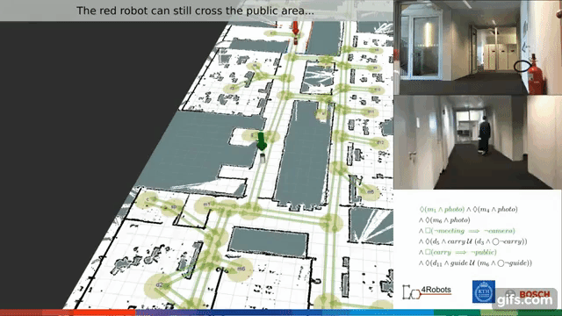
SIMULTANEOUS TASK ALLOCATION AND PLANNING UNDER UNCERTAINTY
Presented by:
Abdolhadi Rezaei
Maryam Bandali
Oluwatoyin Yetunde Sanni
Mohammed Sukhsarwala

Slide 2






PRESENTATION BREAKDOWN
INTRODUCTION &
PRELIMINARIES
STAPU WITH
REALLOCATION
STAPU PROBLEM
FORMULATION
EVALUATION & SCENARIO

Slide 3
Application of allocating a collection of independent tasks to a team of Robots
Most existing approaches consider the separation of task allocation(TA) and planning
Advantages:
Complexity Reduction
Increase the efficiency of task allocation computation
Disadvantages:
Unable to consider TA in planning process
MARYAM‌ BANDALI

Slide 4



Simultaneous Task Allocation and Planning (STAP)
Formalization of Simultaneous Task Allocation & Planning Under Uncertainty (STAPU).
Adaptation of Techniques from formal verification of probabilistic systems to solve this problem.
An extension of approach to address reallocation when failure comes up.
MARYAM‌ BANDALI

Slide 5
INTRODUCTION
Individual robots’ capabilities and environments
Markov decision processes (MDPs)
Set of task Specification
Linear temporal logic (Co-safe)
Specification of safety constraints (safe LTL)
Generating multi robot policies
Basic Task allocation and Planning
Team MDP
Iteratively improvement of the policies in case of failures
MARYAM‌ BANDALI

Slide 6

MARKOV DECISION PROCESS
ABDOLHADI REZAEI

Slide 7

MARKOV DECISION PROCESS
ABDOLHADI REZAEI

Slide 8
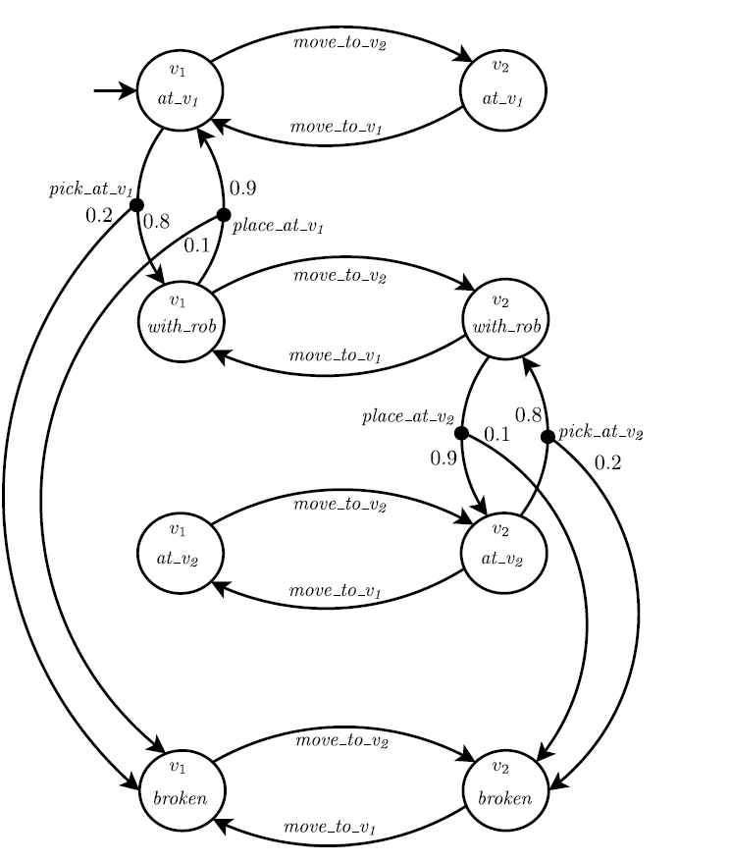
EXAMPLE
Consider a robot that can move between two locations v1 and v2.
A water bottle is placed in location v1 and the robot can pick it up and place it back in both locations.
We assume a probability 0.8 of successfully picking up the object without breaking it, a probability 0.9 of successfully placing the object without breaking it, and that the robot can navigate between locations v1 and v2 without failing.
We can model this example as a factored MDP, with X = {robot loc; obj state}.
ABDOLHADI REZAEI

Slide 9
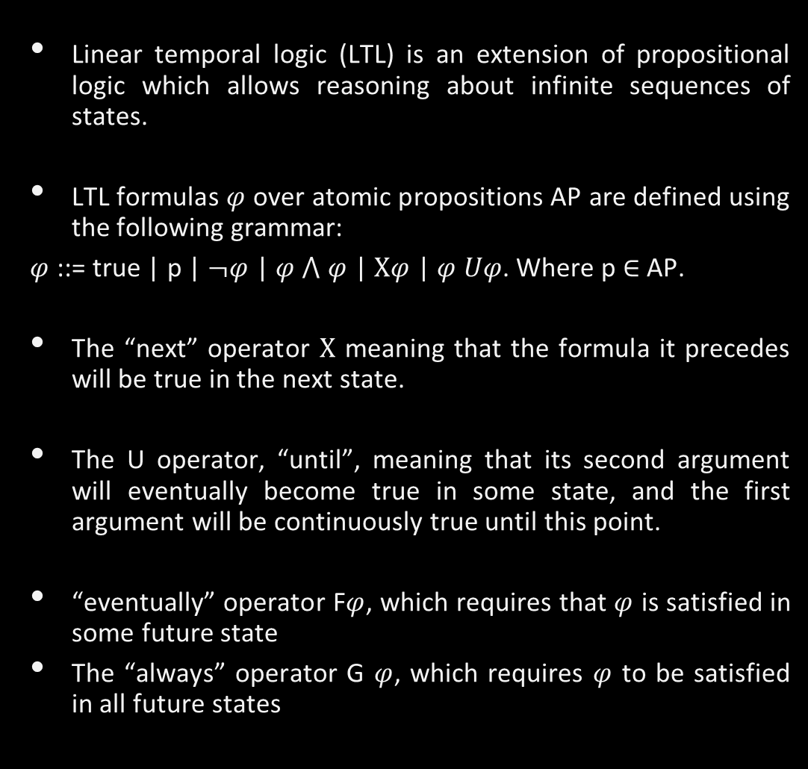
Linear Temporal Logic
ABDOLHADI REZAEI

Slide 10
SAFE AND CO-SAFE NOTIONS IN LTL
We are interested in specifying behaviors that occur within finite time. So we use two subsets of LTL which are safe and co-safe LTL
🡪Based on notion of bad and good prefix
Bad prefix:
🡪 In order to formally define what safety properties are, we refer to computations of a nonterminating system as infinite words over an alphabet Σ . Typically, Σ = 2^𝐴𝑃, where AP is the set of the system's atomic propositions. Consider a language L of infinite words over Σ. A finite word x over Σ is a bad prefix for L, if for all infinite words y over Σ , the concatenation x . y of x and y is not in L.
Good prefix
🡪Let 𝜑 be an LTL formula and 𝜎 = 𝜎_0 𝜎_1…∈ 〖〖(2〗^𝐴𝑃)〗^𝜔such that 𝜎 ⊨𝜑 . We say that 𝜎 has a good prefix for 𝜑 if there exists n ∈ ℕ for which the truncated finite sequence 𝜎|𝑛┤ = 𝜎_0 𝜎_1… 𝜎_𝑛 is such that for every 𝜎^′∈ 〖〖(2〗^𝐴𝑃)〗^𝜔 the concatenation 𝜎|𝑛┤ . 𝜎^′ ⊨𝜑.
ABDOLHADI REZAEI

Slide 11
SAFE AND CO-SAFE NOTIONS IN LTL
Syntactic Restriction. we assume a syntactic restriction for safe and co-safe LTL. We assume that all formulas are in positive normal form (negation can only appear next to atomic propositions).
Syntactically, safe LTL is the set of formulas for which only the G and X temporal operators occur
Syntactically , co-safe LTL is the set of formulas for which only the X, F and U temporal operators occur
ABDOLHADI REZAEI

Slide 12
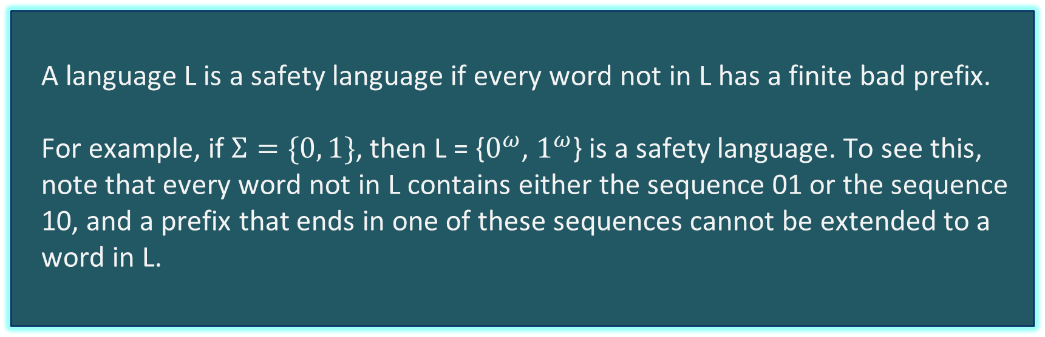
SAFE PROPERTY EXAMPLE
ABDOLHADI REZAEI

Slide 13
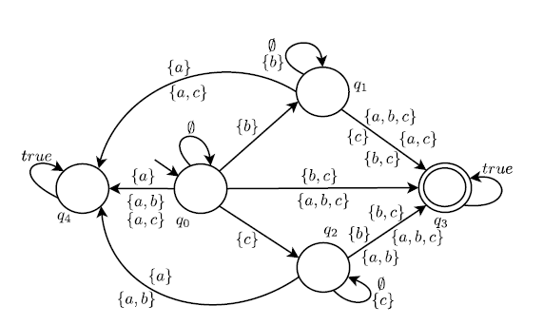
SAFE PROPERTY EXAMPLE
Consider the syntactically co-safe LTL specification 𝜑 = ((¬a) U b) ⋀ ((¬a) U c).
ABDOLHADI REZAEI

Slide 14
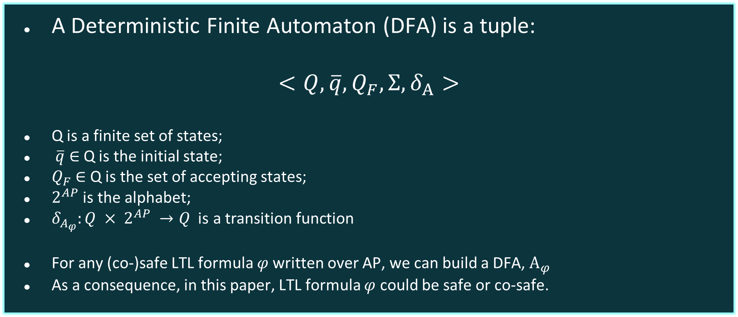
DETERMINISTIC FINITE AUTOMATON (DFA)
ABDOLHADI REZAEI

Slide 15
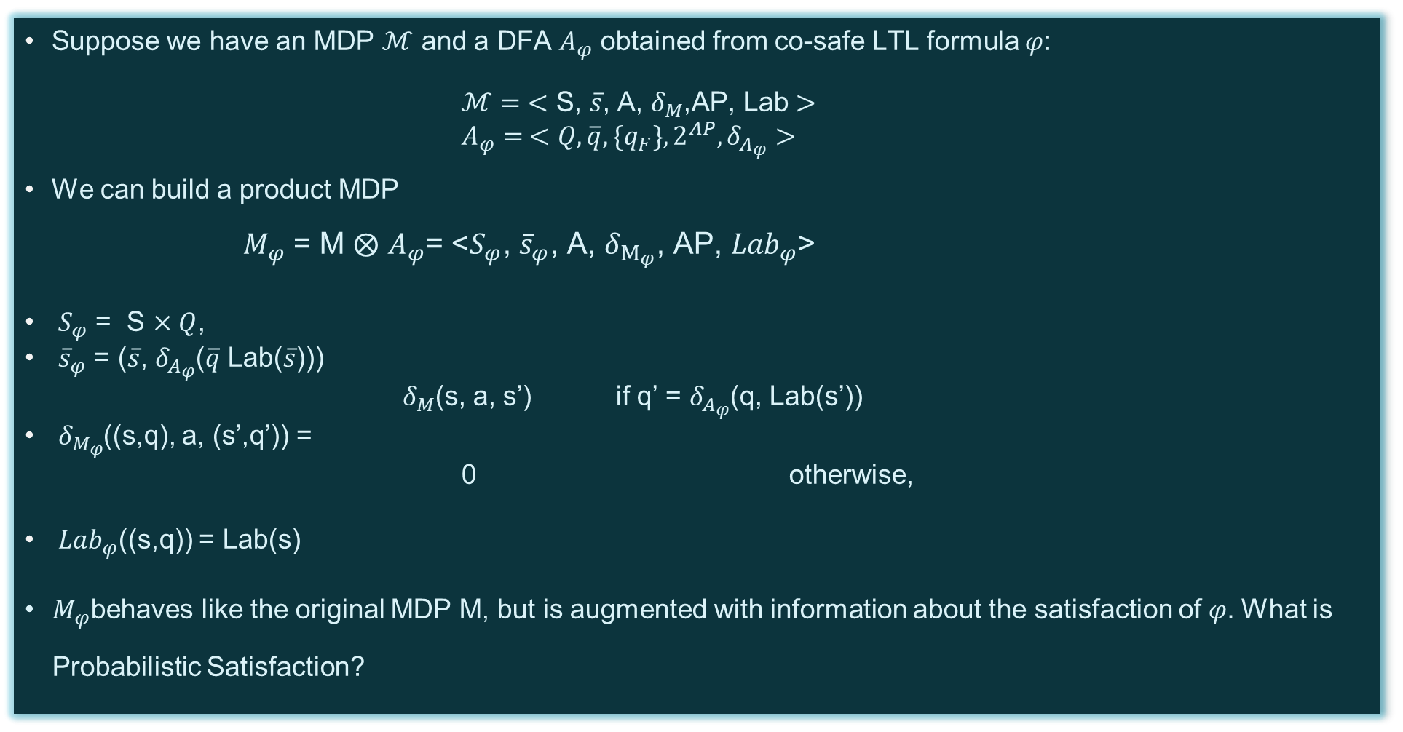
OPTIMAL POLICIES FOR (CO)-SAFE SPECIFICATIONS
ABDOLHADI REZAEI

Slide 16
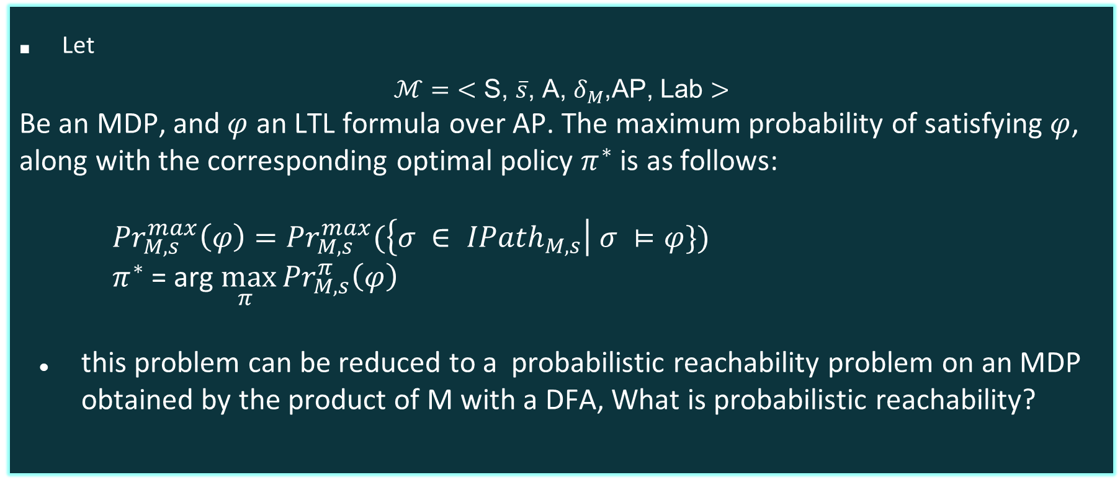
PROBABILISTIC SATISFACTION
ABDOLHADI REZAEI

Slide 17
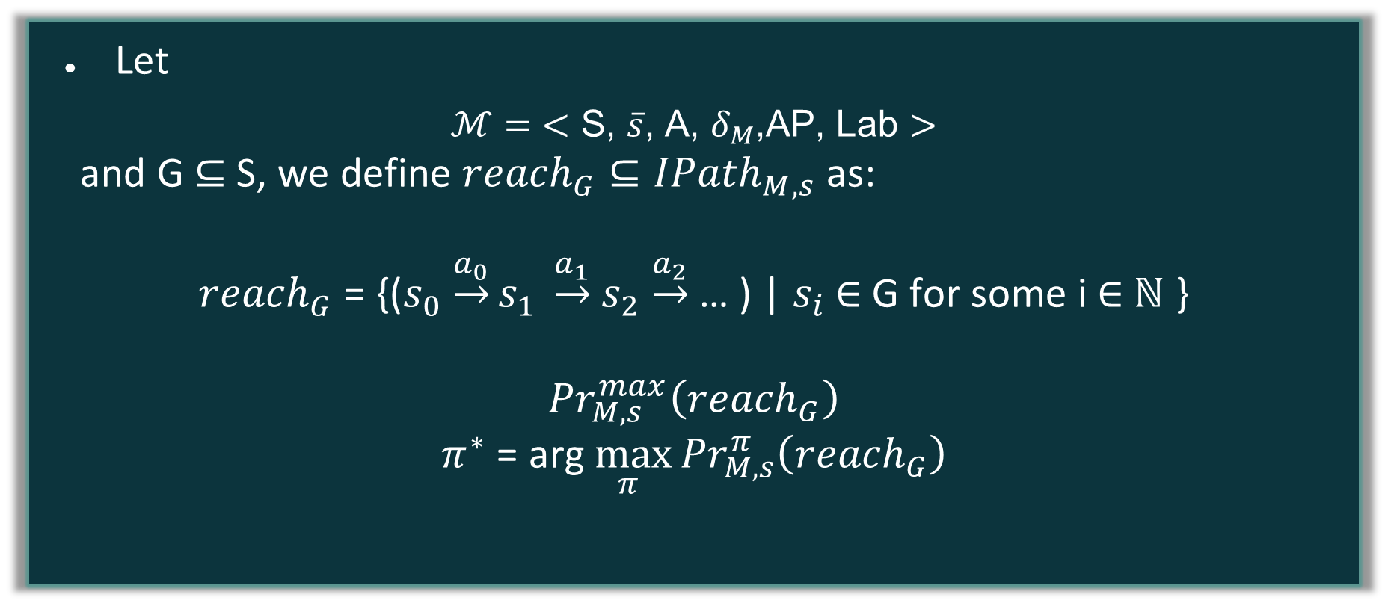
PROBABILISTIC REACHABILITY
ABDOLHADI REZAEI

Slide 18
STAPU - PROBLEM FORMULATION
LTL
ROBOTS
MISSION
𝑀 = (𝛟, 𝜑safe) where
𝛟 = {𝜑₁,.....,𝜑ₘ} set of co-safe LTL task specifications
𝜑_{safe} is a single safety specification.
𝑅 = {r₁,…..,rₙ} is the set of robot(agents)
The operation of each agent rᵢ is modelled by an MDP(ℳٖᵢ ).
Probabilities in each MDP
may represent either uncertainty in its environment or the possibility of failure.
In particular, the LTL specifications here are decomposed such that they are independent.
OLUWATOYIN SANNI

Slide 19
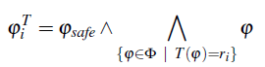
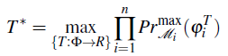
Given 𝑅 and 𝑀 from previous slides, we then define STAPU problem as a Task allocation mapping in a joint manner such that: 𝑇*: 𝛟 🠂 𝑅
We describe the LTL specification φ_{i}^{T} as the conjunction of tasks for each robot, given task allocation 𝑇.
STAPU
-
PROBLEM FORMULATION
00000
➤
OLUWATOYIN SANNI

Slide 20

STAPU - PROBLEM FORMULATION
INDEPENDENT TASKS
We consider each robot taking turns independently when solving a single STAPU problem because the tasks are executed in a parallel manner.
OPTIMAL POLICIES
As we have observed, solving a STAPU problem is effectively finding a joint policy such that we have a task allocations mapping, and actions to each robot as seen with T*
LOCAL MDP
In order to find an optimal policy for each robot, it is assumed that tasks have no interdependence and can each be completed by a single robot. Hence, this brings us to a local MDP.
OLUWATOYIN SANNI

Slide 21
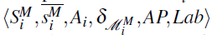
LOCAL MDP
Each MDP encodes the dynamics of each robot, its tasks and the extent of task completion. A product MDP with a separate DFA for each LTL formula is defined as
ℳٖ_{i}^{M} = ℳٖi ⨂ A𝜑₁ ⨂……..⨂ A𝜑ₘ ⨂ A𝜑_{safe}
⇓
ℳٖ_{i}^{M} =
Given 𝖰𝜑i as the DFA for each task, the state space S_{i}^{M} of the local MDP ℳٖ_{i}^{M} is denoted as
S_{i}^{M} = S_{i} ⨉ 𝖰𝜑₁ ⨉ … ⨉ 𝖰𝜑_{n} ⨉ 𝖰𝜑_{safe}
which allows us to keep track of the state of satisfaction for each part of the mission specification separately.
OLUWATOYIN SANNI

Slide 22

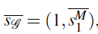
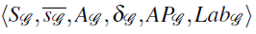
TEAM MDP
The team MDP 𝒢 is the union of the n local product MDPs
ℳٖ_{i}^{M}...ℳٖ_{n}^{M}
We construct a team MDP that represent each robot sequentially.
MDP 𝒢 is a tuple
S_{G} keeps track of the current robot and its current state within its local MDP.
r₁ in its initial state
A_{G}= {𝜻} ∪ ⋃ⁿ_{i=1} A_{i} is the special switch transition 𝜻 used for tasks allocations from r_{i} to r_{i+1} UNION the action space that contains individual robot actions
OLUWATOYIN SANNI

Slide 23
TEAM MDP
EXPANSION
For an action space ⋃ⁿ_{i=1} A_{i}, the corresponding local product MDP ℳٖ_{i}^{M} transition function is mapped this way:
𝛿_{G}((i,sᵢ,), a, (i,s’ᵢ,)) =
𝛿_{ℳᴹ} (sᵢ, a, s’ᵢ,).
For an action a= 𝜻 , the transition function updates the system to plan for the next robot 𝛿_{G}((i,s), 𝜻, (j,s’)) = 1 if some conditions hold.
Neptune is the fourth-largest planet in our Solar System
OLUWATOYIN SANNI

Slide 24
2
1
3
j = 1 + (i % n)
the robots are connected in a ring topology
The state of all the tasks is preserved and we do not switch during the execution of a task.
s’ corresponds to an initial state of robot j. i.e s’= where represents the LTL specifications.
For other pairs of states where 𝛿G((i,s), 𝜻, (j,s’)) = 0, we omit the propositions AP_{G} and labelling function Lab_{G}
OLUWATOYIN SANNI

Slide 25
PROBLEMS
WITH STAPU
Even though the tasks in team MDP are addressed in a sequential order, the generated policies are to be executed in parallel by the team. This leads us to AMBIGUITIES at execution time. How?
Because they run in parallel, it’s hard for r_{i+1} to know how the 1,...i’s policies will evolve. This is a partial observability scenario.
OLUWATOYIN SANNI

Slide 26
THE SOLUTION
How do we solve this?
With the use of a particular class of single robot MDPs where this uniqueness of a switch transition occurs. MDPs with a designated failure state.
where actions either move to a next state s’ with probability 𝑥 or fail with probability 1 - 𝑥.
OLUWATOYIN SANNI

Slide 27
STAPU WITH REALLOCATION
What happens when a task fails to be completed by a Robot?
Reallocation to another member of the TEAM MDP is the approach.
How is the Reallocation DONE??
A new switch transition is added which are used to perform this reallocation. We build a joint model representing the synchronized evolution of the system just under the computed STAPU policies, i.e., we build the synchronized multi-robot policy for the STAPU solution, where, at each state, each robot executes the action corresponding to its policy in a joint fashion.
MOHAMMED SUKHSARWALA

Slide 28
STAPU WITH REALLOCATION
BREAKDOWN
This new switch transition outcome is used to describe the states each robot might be at the point in time when failure occurred. However, the need to synchronize in the TEAM MDP is crucial.
At each state s, each robot r(i) executes the action corresponding to its policy in a joint fashion. This ri model has a set of reallocation states corresponding to situations where some robots have previously failed. We then choose one of these reallocation states as the initial state of a new STAPU instance with a switch transition.
MOHAMMED SUKHSARWALA

Slide 29
STAPU WITH REALLOCATION
Theoretical Approach to the Breakdown
Let Sr= (s₁,…..,sₙ, ɋ𝜑1,...,ɋ𝜑m,ɋ𝜑safe) be an example of a reallocation state in the synchronized multi-robot policy, where si is the failure state to be addressed.
A modification was made to the previous team MDP as shown below
Previous Team MDP | Modified Team MDP
MDP 𝒢 = where which represents the r₁ in its initial state. Here, the switch transition point to the initial state of the next robot. | MDP 𝒢 = where maps to Sr above. Here, the switch transition point to the current state of the next robot in the reallocation state s1 + (i mod n)
MOHAMMED SUKHSARWALA

Slide 30
STAPU WITH REALLOCATION
By solving this new STAPU instance, we effectively find a reallocation policy from the chosen reallocation state. We can then use the reallocation policy to continue building the synchronized multi-robot policy from Sr= (s₁,…..,sₙ, ɋ𝜑1,...,ɋ𝜑m,ɋ𝜑safe) and then choose a new reallocation state to address. We choose the next reallocation state to address in decreasing order of reachability probability, i.e., we start by addressing the most probable reallocation states.
When all reallocation states have been addressed, we terminate the procedure. Note that because we choose the next reallocation state to address in decreasing order of reachability probability the algorithm is anytime, in that it can be terminated at any point and provide a (incomplete) solution, and the longer it runs the more cases it will cover.
We finish by noting that this approach can be extended to also include expected team sum of costs minimization by defining a cost structure (representing navigation duration for example) for each robot and using nested value iteration to generate policies.
MOHAMMED SUKHSARWALA

Slide 31
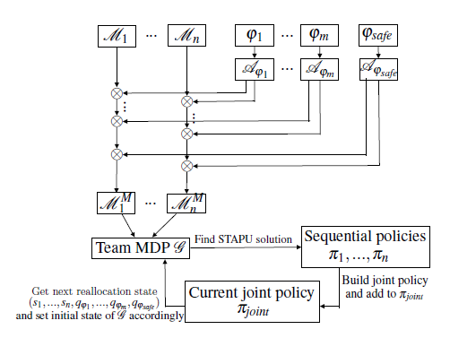
STAPU WITH REALLOCATION DIAGRAM ILLUSTRATION
MOHAMMED SUKHSARWALA

Slide 32
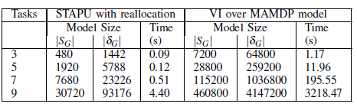
STAPU EVALUATION
The paper implemented STAPU with reallocation in the PRISM model checker, which supports solving MDPs for LTL properties. In this example, they had 30 states, 2 robots with an initial 5 failure points per robot model. The mission M = (𝛟, 𝜑_{safe}) where
𝛟 = {𝜑₁,..,𝜑ₘ}
𝜑_{I}= ⃟ p_{i}
𝜑_{safe} = ⃞ ￢p and p_{i} ∈ AP
They evaluated the scalability of the approach with respect to the number of robots and tasks in the model, and the time of completion. As observed, STAPU had lesser model sizes and computation time, compare to Value Iteration algorithm over full multi-agent MDP(MAMDP.)
MOHAMMED SUKHSARWALA

Slide 33
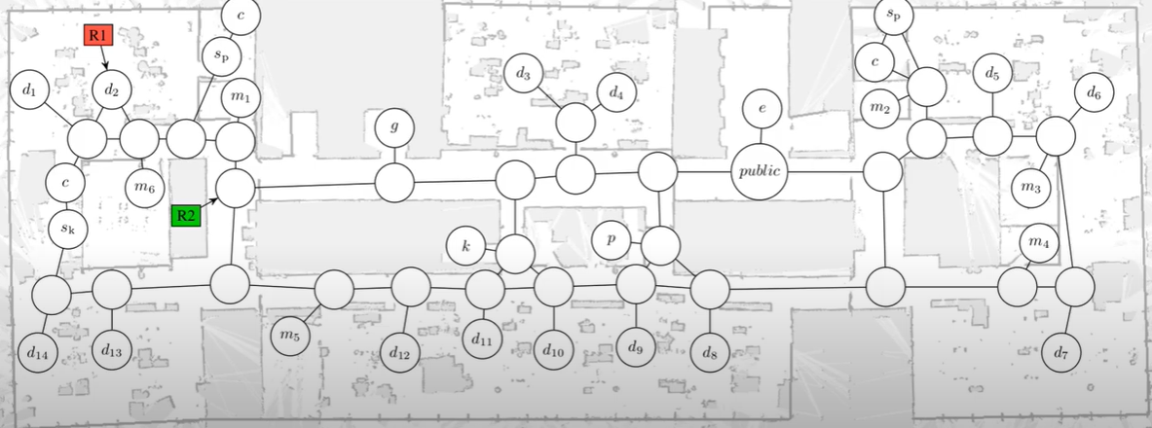
SCENARIO
This scenario illustrates applicability of the presented simultaneous task allocation and planning (STAP) framework to real-world problems.
We consider an office scenario with 2 robots available at the indicated locations.
MARYAM‌ BANDALI

Slide 34
Tasks to be completed:
Take a photo in the meeting rooms m1 , m4 , and m6
Deliver a document from desk d5 to d3
guide a person waiting at desk d11 to meeting room m6
The camera has to be turned off for privacy reasons while not in meeting rooms
The document is internal such that it should not be delivered through any public areas.”
MARYAM‌ BANDALI

Slide 35
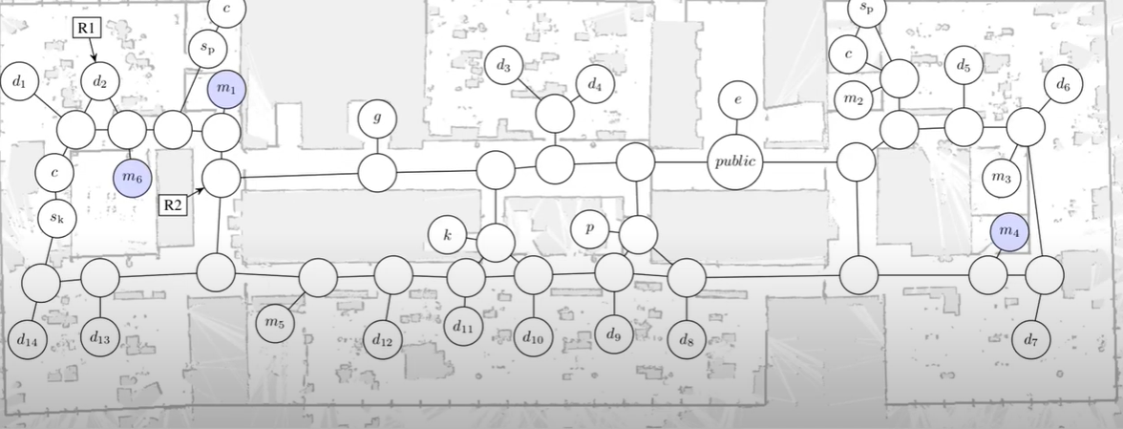
The robots should take a photo of notes in each of the highlighted meeting rooms.
MARYAM‌ BANDALI

Slide 36
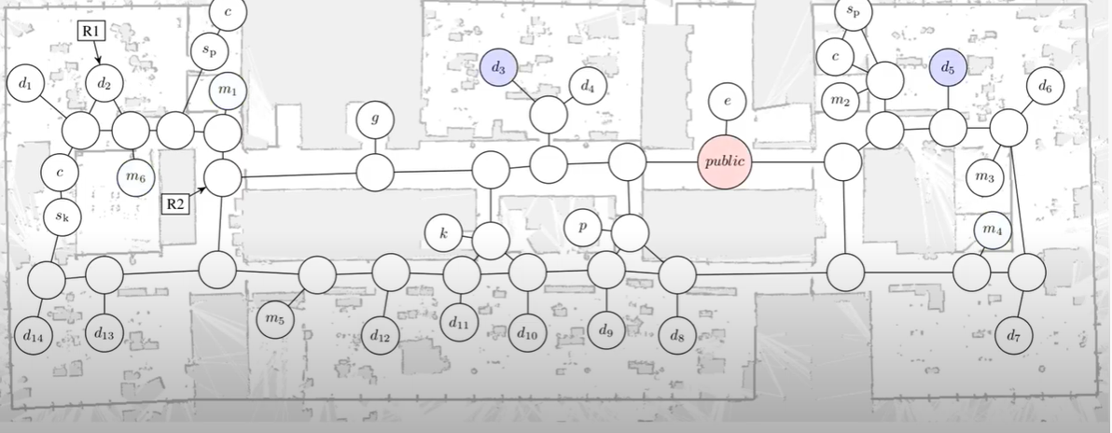
Deliver a document from d5 to d3 and avoid public areas while carrying it.
MARYAM‌ BANDALI

Slide 37
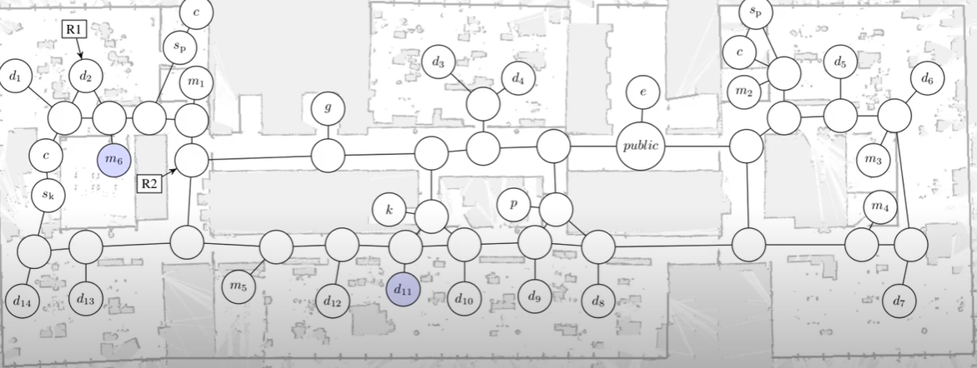
… And guide a person at d11 to the meeting room m6.
MARYAM‌ BANDALI

Slide 38
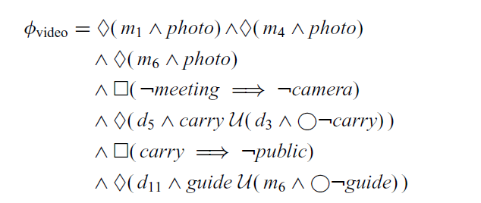
Robot behaviors are generated to fulfill the given specification:
Independent parts (“tasks”) of the specification are automatically identified
Task allocation and planning is done simultaneously
The planner finds actions to minimize the maximal execution time each robot will execute its assigned plan independently
MARYAM‌ BANDALI

Slide 39
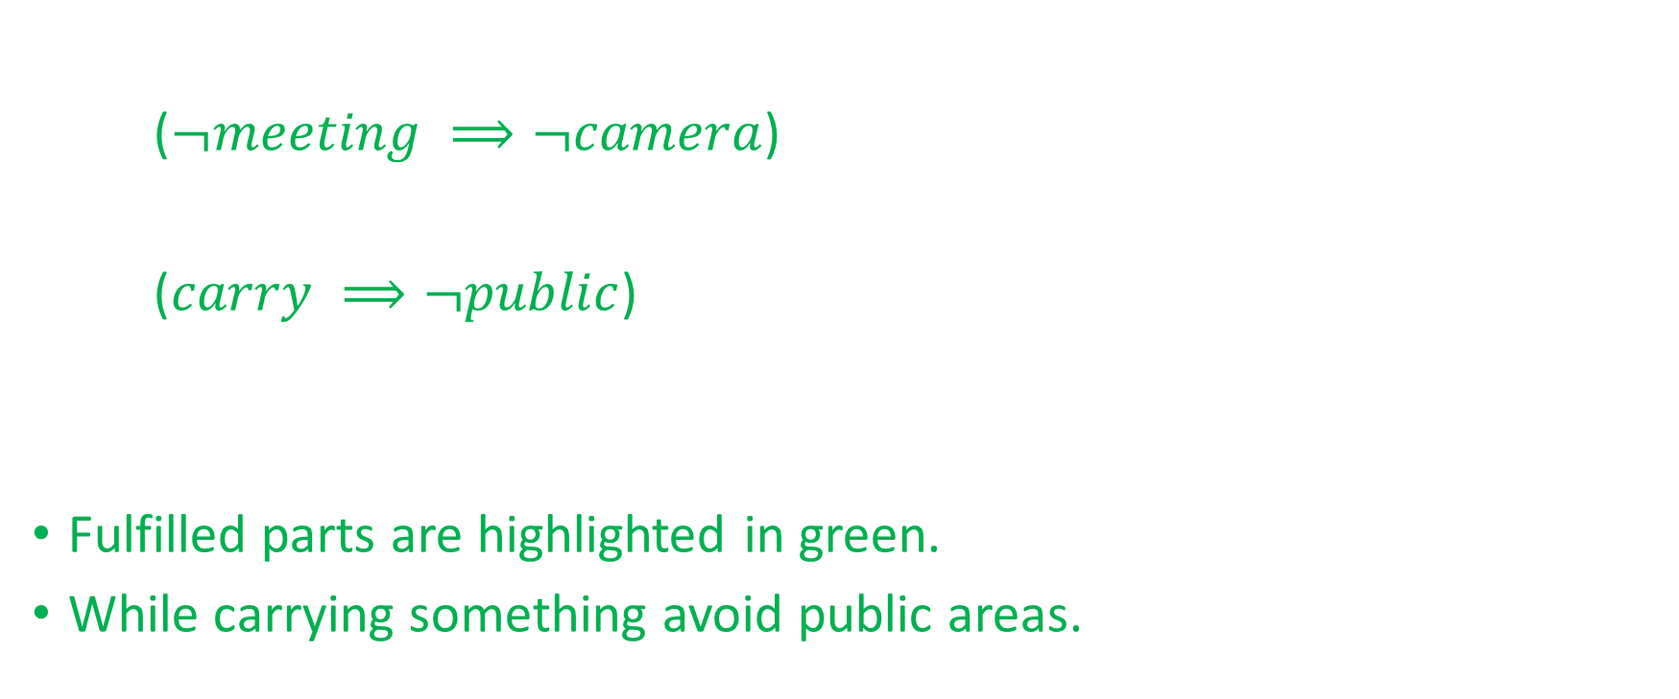
MARYAM‌ BANDALI

Slide 40

MARYAM‌ BANDALI

Slide 41
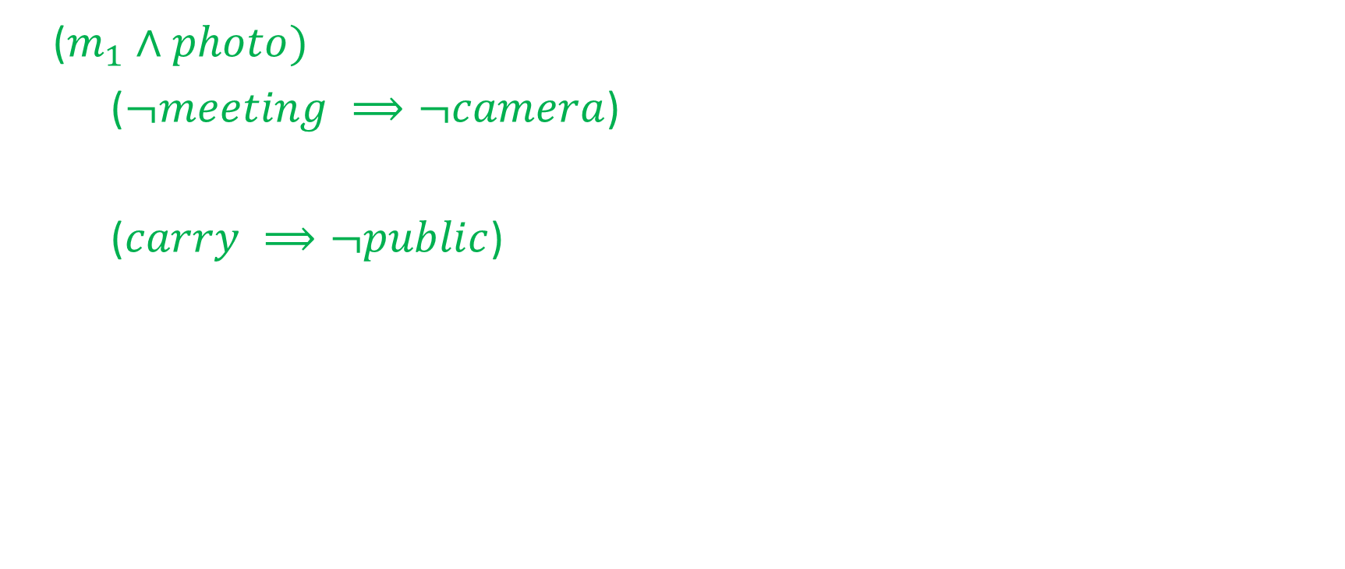
Done: “ Take a photo in meeting room m1”
MARYAM‌ BANDALI

Slide 42
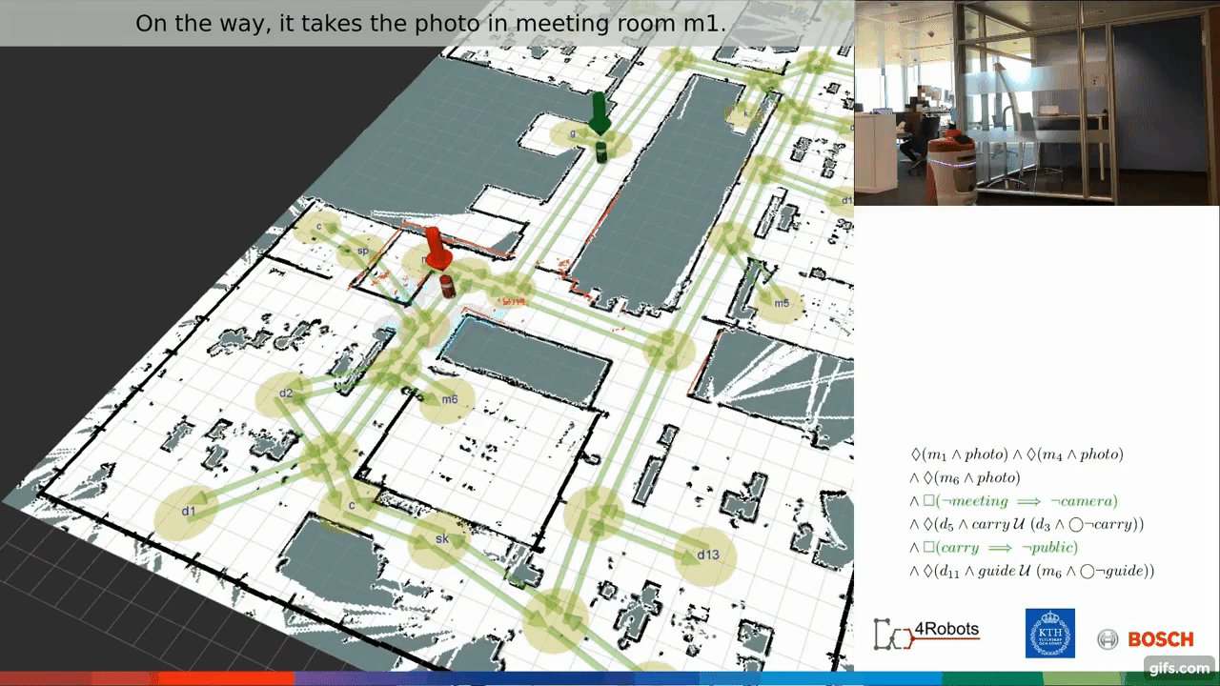
MARYAM‌ BANDALI

Slide 43
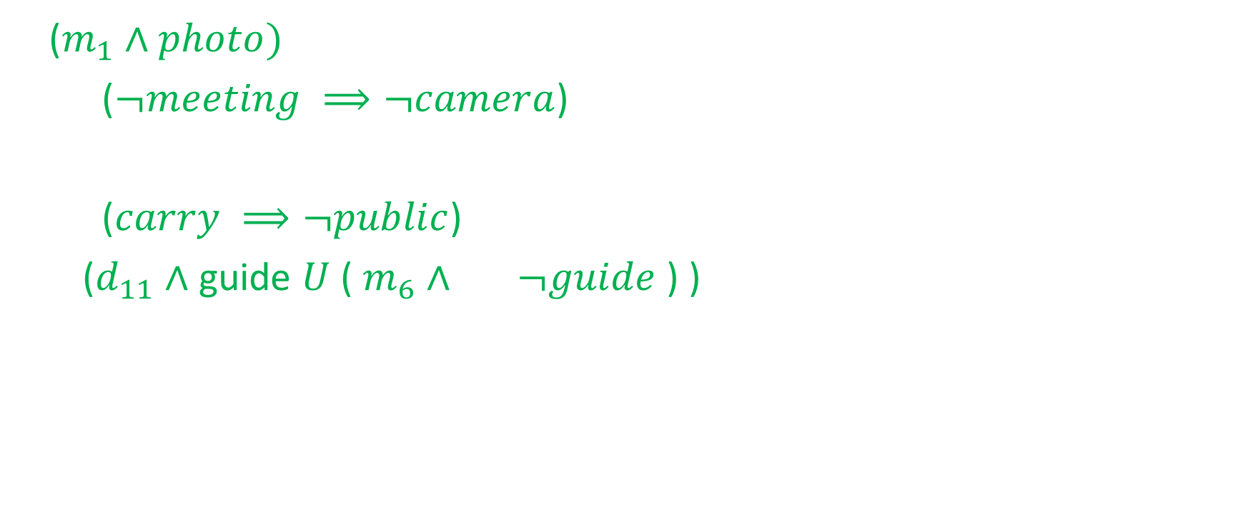
Done: “ Guide a person at d11 to the meeting room m6”
MARYAM‌ BANDALI

Slide 44
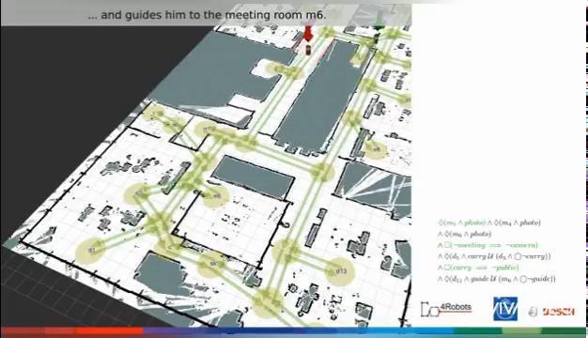
MARYAM‌ BANDALI

Slide 45
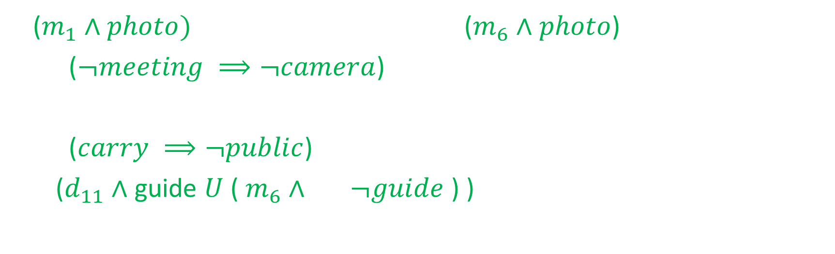
Done: “ Take a photo in meeting room m6”
MARYAM‌ BANDALI

Slide 46
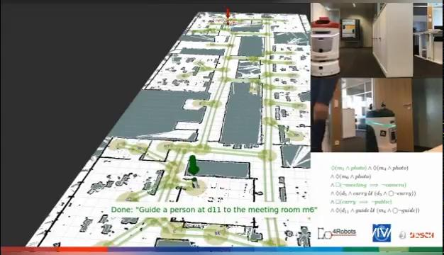
MARYAM‌ BANDALI

Slide 47
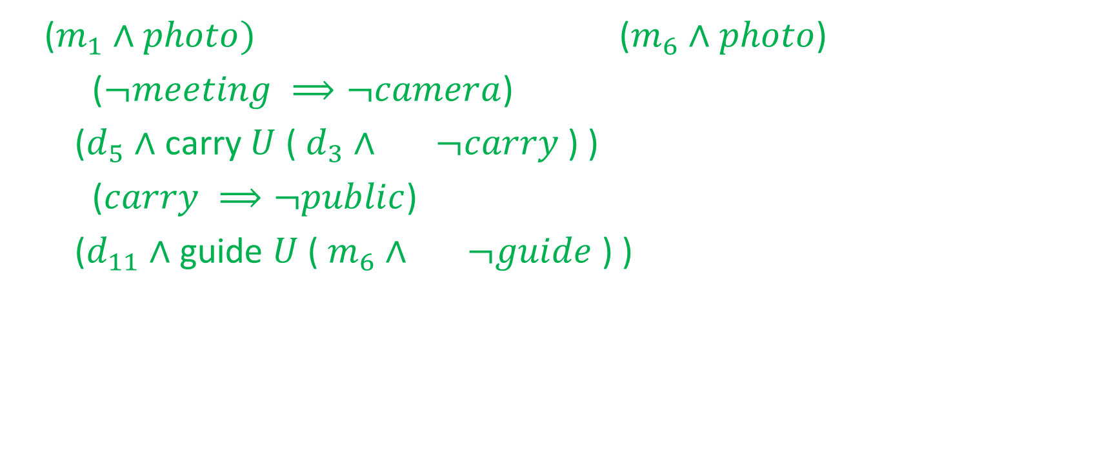
Done: “ Deliver a document from d5 to d3 ”
MARYAM‌ BANDALI

Slide 48
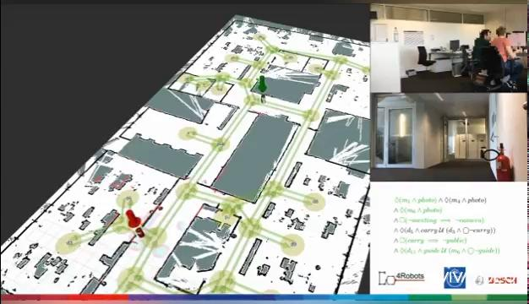
MARYAM‌ BANDALI

Slide 49
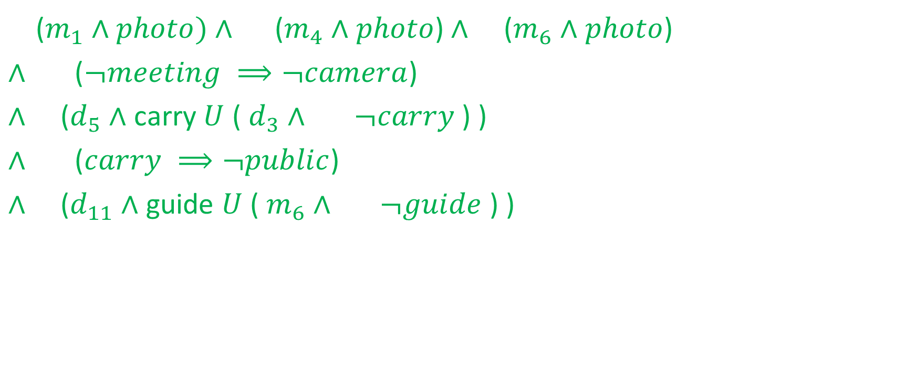
Done: “Take a photo in meeting room m4”
MARYAM‌ BANDALI

Slide 50
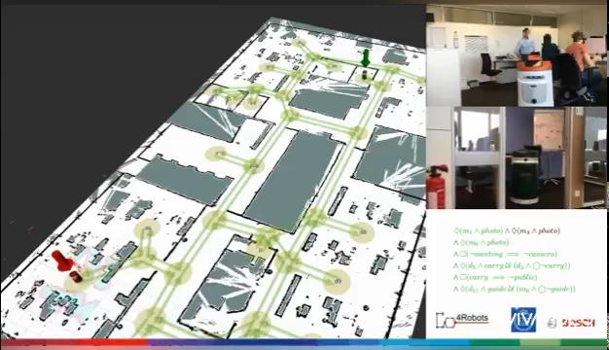
MARYAM‌ BANDALI

Slide 51
References
F. Faruq, B. Lacerda, N. Hawes and D. Parker, “Simultaneous Task Allocation and Planning Under Uncertainty”, 2018 IEEE/RSJ International Conference on Intelligent Robots and Systems (IROS) Madrid, Spain, October 1-5, 2018
P. Schillinger, M. Bürger, and D. V. Dimarogonas, “Simultaneous task allocation and planning for temporal logic goals in heterogeneous multi-robot systems,” IJRR, vol. 37, no. 7, 2018.
P. Schillinger, M. Burger, and D. V. Dimarogonas, “Decomposition of finite LTL specifications for efficient multi-agent planning,” in DARS, 2016.
B. Lacerda, D. Parker, and N. Hawes, “Nested value iteration for partially satisfiable co-safe LTL specifications,” in AAAI Fall Symposium on Sequential Decision Making for Intelligent Agents, 2015.
Principles of model checking / Christel Baier and Joost-Pieter Katoen ; foreword by Kim Guldstrand Larsen.

